Slide 1

Before internship

Slide 2

After the Internship
Expectation

Slide 3

After the Internship
Reality

Slide 4
I learned:
SQL – basic level
NoSQL – basic level
Hadoop/ Hive – understanding level
HTML- Consolidated
CSS – Consolidated
Google Map API – basic level
D3.js – basic level
JavaScript - Intermediate

Slide 5
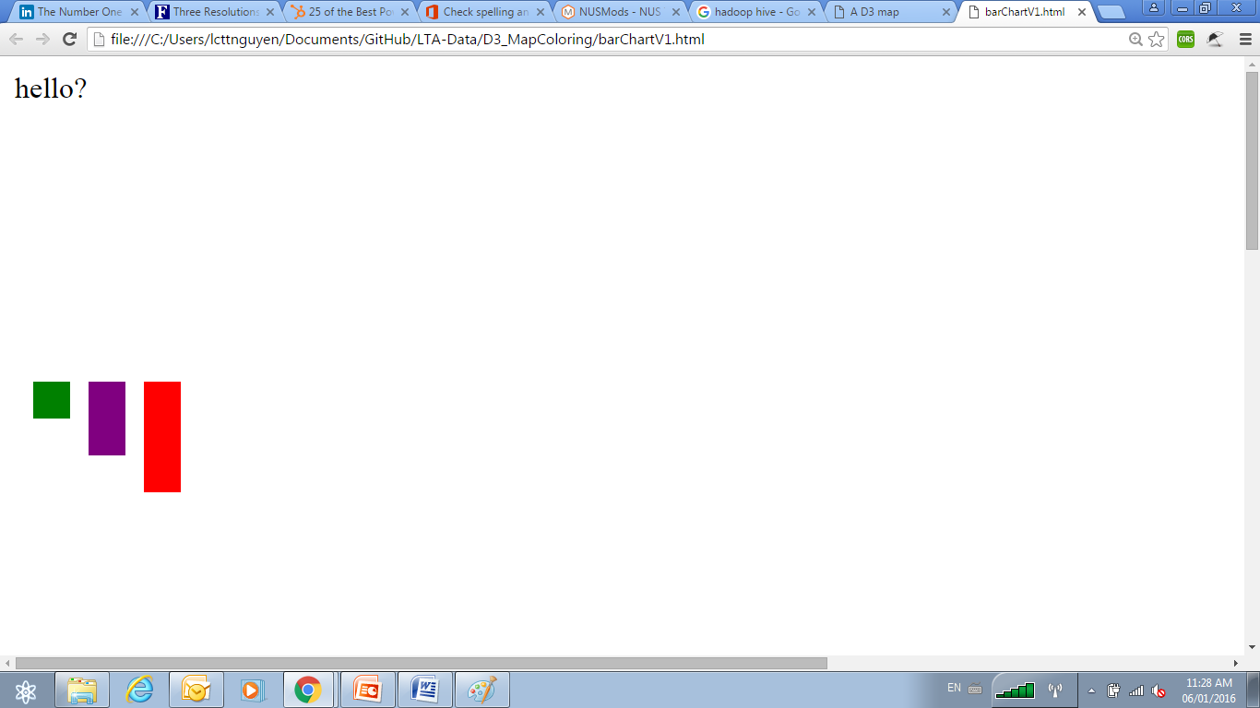
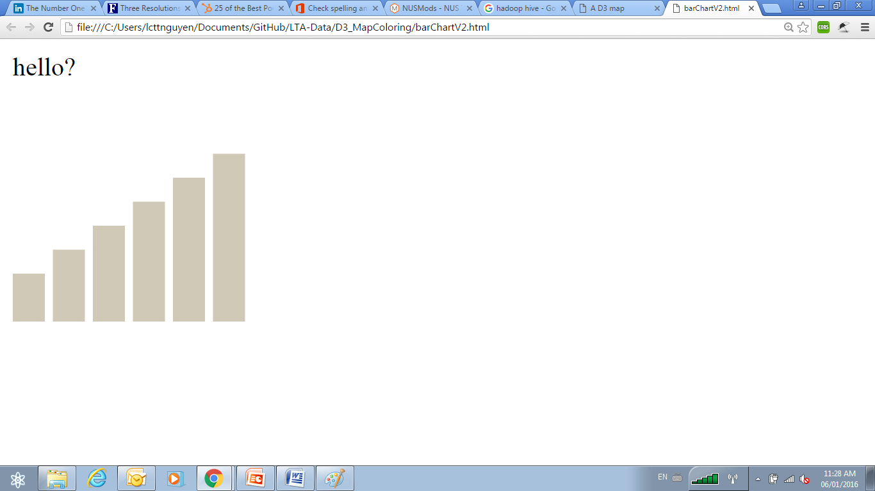
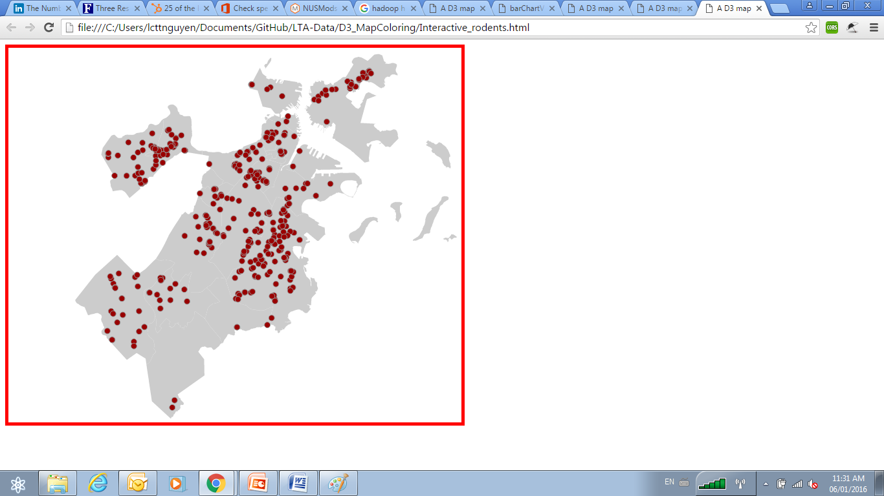
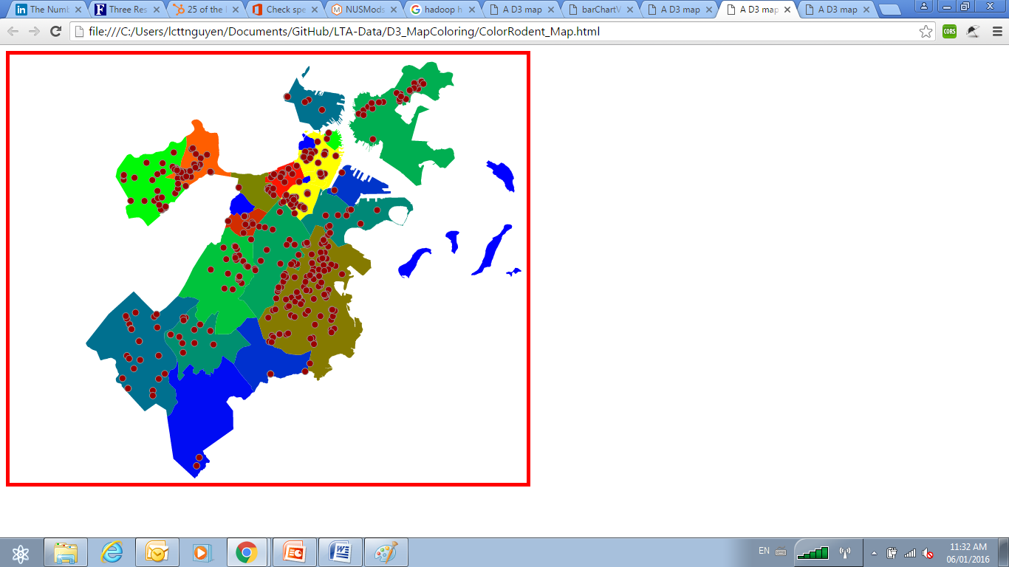
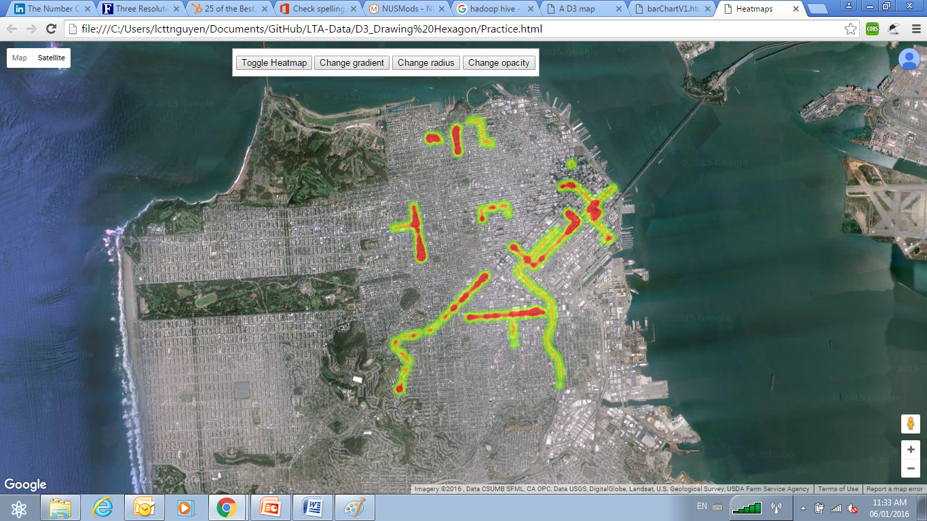

Slide 6
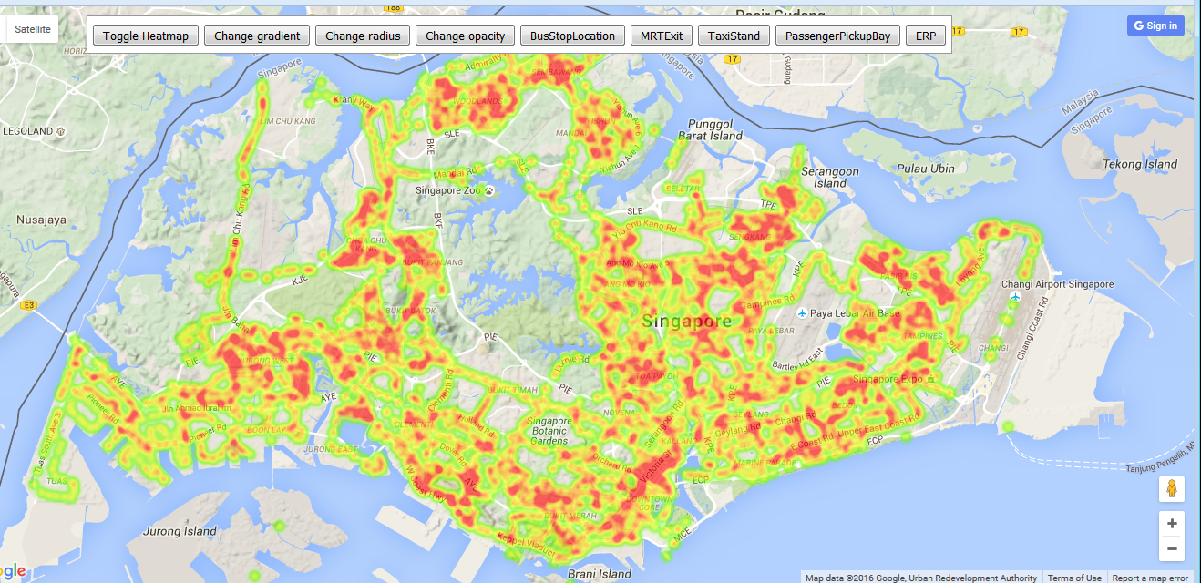
Heat Map using Google API

Slide 7
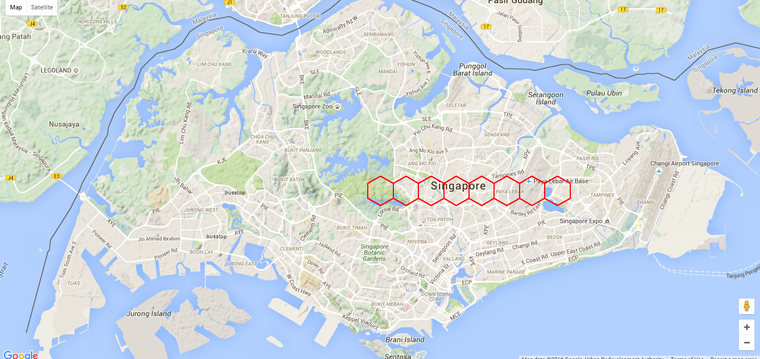
Using D3.JS

Slide 8
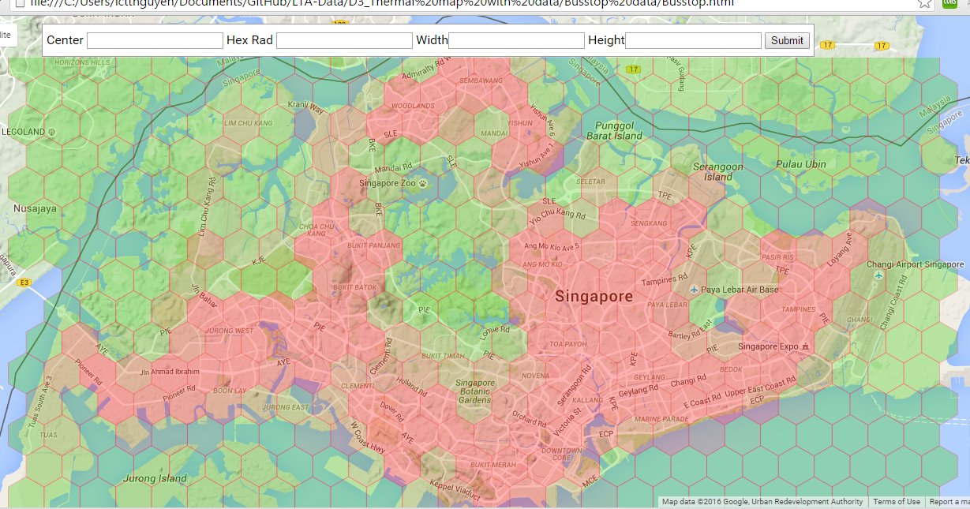
Finally

Slide 9

Benefits of Big Data

Slide 10


Ways of Implementation
Use Cases
Potential Spill-Over Effect
Data exposure & API enablement
Matching demand & offering nearby
Real time analysis
Congestion control
Dynamic profiling and segmentation
Effecting marketing
Segmentation of customers for accurate marketing campaign
Enable location-based and personalized advertising

Slide 11
Data exposure & API enablement

Slide 12
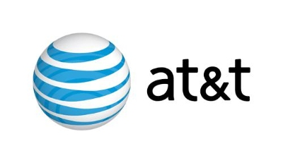

Slide 13
Miso- Tech Startup
Customer:
MISO- Tech Startup in San Francisco
Industry:
Mobile Application
Problem:
Miso app, social TV application
Solution:
AT&T U-Verse API Platform
Notes:
Miso, headquartered in San Francisco, California, is a growing application development firm. Its interactive application connects with TV receivers to give users an integrated, data-rich TV viewing experience.
Problem: Miso wanted to detect the AT&T U-verse TV content in real time to provide an easy to use, complementary second-screen experience, giving users information relevant to the shows they watch.

Slide 14

Break Down of The Problem
People uses smart phone/ tablet computer while watching TV
Urge to share show information on social media
Need to search Show details
Real-time show-related search. E.g. songs, products, commercial, etc
Notes:
“Increasingly, people are watching television on their smartphones and tablet computers, and they want to be continuously connected socially while watching”
“Rather than just watching TV, they want to chat with friends about which shows they’re watching and have a deeper relationship with the shows they are watching.
“For example, someone might want to instantly find out the name of a song playing on a TV commercial, but without having to search for it on the Internet.” or the searching the product of that commercial, or searching other information about the show plots.

Slide 15
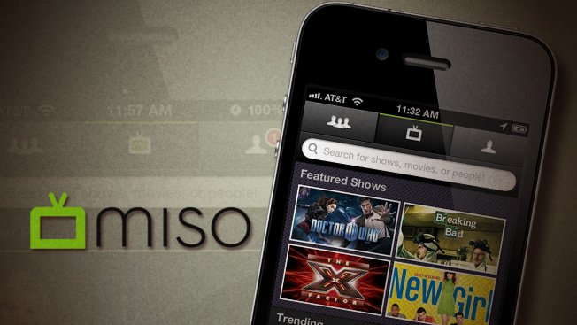
Solution
In late 2010,
Publish Miso IOS App
Integrating AT&T
U-verse API
Able to search content
View current play show, TV Schedule.
Change content
Notes:
In 2010, Miso started developing a new version of its application that could be fully integrated to work with the AT&T U-verse TV receivers.
Once an application is associated with the receiver, it can send remote-control commands, receive updated data on specific shows being watched, detect channel changes, and direct the receiver to display relevant and compatible content from hosted URLs.

Slide 16


Provides tools to create a complementary experience to the U-verse TV service.
Gives users a fully connected, interactive experience.
Offers strong support.
Notes:
Provides tools to create a complementary experience to the U-verse TV service, including remote control, TV metadata detection, and the ability to use the TV as an alternate display.
Gives users a fully connected, interactive experience.
Offers strong support.

Slide 17
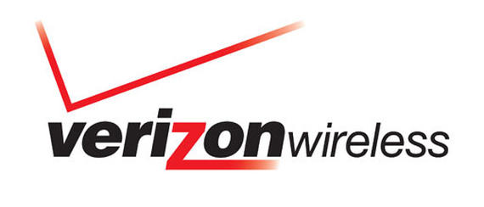

Slide 18

Verizon Service Control Gateway Architecture
3rd Party
Server
3rd Party
Server
3rd Party
Server
Network API Gateway
Privacy Manager –Provided by Oracle
Communication services: SMS, MMS, Terminal Location
**Actual architecture can be found in Appendix
Notes:
Verizon Wireless exposes a range of Network APIs that allow partners and third party application developers to design applications using Verizon’s network capabilities.
Basically, Verizon provides
» Location APIs support;
» Granular (precise) or AGPS location; and
» Coarse (cell ID-based) location.
» Messaging APIs support send, receive and delivery receipt to Verizon wireless subscribers; and
» Admin APIs support aggregator and enterprise features.

Slide 19

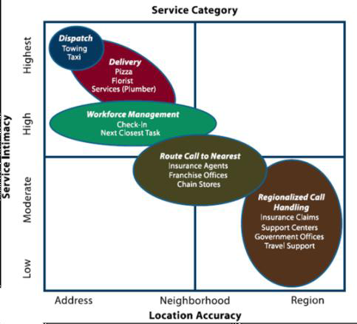
Verizon Customers
Reduce Dispatch Cost
Automatic routing call
Reduce call time and hassle of Location
Notes:
TechnoCom is a leading provider of products and services to deliver wireless and location-based services applications.
The concept of the “location enhanced” call center and IVR is simple, customer services use the knowledge of the caller’s location to improve the services delivered, resulting in a faster, more economical, and better customer experience, Figure 4 shows some of the use cases:
» Helping callers even when they don’t know where they are to reduce costly dispatch mistakes and to substantially reduce the costs of customer service time by reducing service call duration.
» Automatically routing calls made to a central number to the local point of sale to leverage the personal service from local stores and franchises to close more sales and deliver better service.
» Reducing the hassle and time in answering the question “Where are you?” to realize service provider cost savings and improve customer satisfaction.

Slide 20

For Example
Confirmation for location base
Schedule and Dispatch Truck
SMS Notification
Gaining from API charges
Notes:
As an example, when someone breaks down and calls roadside assistance, the IVR will confirm it is OK to get the person’s location for only that call. As the agent has the location information, time is saved and human error is removed. Then when the truck is scheduled, an SMS is sent to the person with the truck’s estimated time of arrival and contact information, which further saves call center agent time. The savings enabled by the location and messaging API can be in the order of tens of dollars per event, so the API charges are negligible. The difference in value between the wholesale business of exposing APIs and delivering value to businesses highlights an important consideration for CSPs. As they expose APIs, they are enabling innovation, but the business models created on top of the APIs is where significant value is created.

Slide 21
Matching demand & offering nearby

Slide 22

Telefónica Dynamic Insights (TDI) is part of the Telefónica Digital product family.
TDI is focused on the development of products and services that leverage on Telefónica’s global big data assets.
Provide mobile insight solutions
Use Insights to help organizations and firms
Enabling them to improve their propositions and businesses.

Slide 23
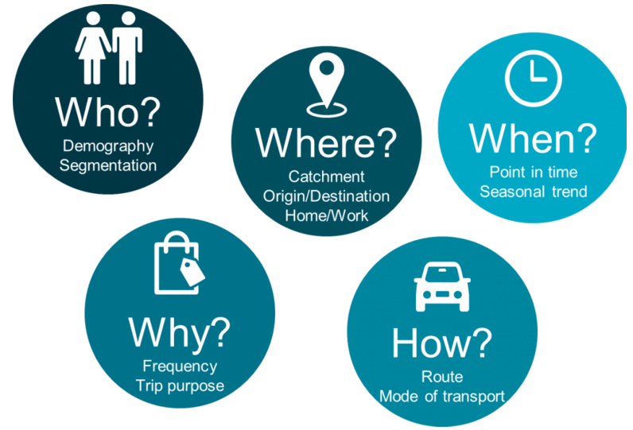
Smart Steps *
*Product of Telefonica Dynamic Insight team
Notes:
Smart Steps processes the “Big Data” created by the mobile network then analyses trends and patterns within the data to help understand more about consumer behaviour including

Slide 24

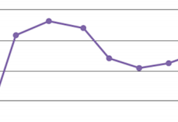

Telefonica O2 – Smart Steps
Measure Compare
Understand factors
Trends & Locations
New policies
Laws
Increase no. of visits
➔New retail outlets
➔Performance
Notes:
Telefonica uses Smart Steps to :
Measure/ Compare/ Understand what factors influences number of ppl visiting a location at any time
Gains insights to tailor local offerings for existing stores & determines best location and most appropriate formats for new stores.
Study the effectiveness of new policies.Help government measures traffic after implementation of new rules. E.g. Free car parking, farmer markets or late night shopping.

Slide 25

Swindon Designer Outlet is a covered designer outlet in Swindon, Wiltshire, England.
The outlet is owned by McArthur Glen
105 stores
3 million shoppers visit per annum

Slide 26
Case 1 : O2 retail smart step case study
Customer:
Swindon Designer Outlet
Industry:
Retail sector
Problem:
Under-performing of outlet
Solution:
Using data to support the theory that the Swindon store was underperforming for its location.
Notes:
O2 Retail approached the Smart Step team to find out
if they could provide data to support the theory that the
Swindon store was underperforming for its location.

Slide 27


Evaluation Process:
23 million
customers
Method: Extrapolate billions of mobile events on its
network to gain insight , which is representative of the total population in each area.
We ended up with a really clear understanding of the store’s catchment and the types of customers we could expect to see
Notes:
Smart Steps uses anonymised
and aggregated mobile network
data from O2’s 23 million
customers. Instead of, traditional
data capture methods are based
on occasional samples, modelled
or claimed behaviour, Smart Steps
takes billions of mobile events on its
network and extrapolates data to
provide insight representative of the
total population in each area.

Slide 28


Clear understanding of catchment and Customer types
Action: Expansion of business into adjoining unit, and employ more staffs
72% increase footfall
14% increase sales
Notes:
We ended up with a really clear
understanding of the store’s
catchment and the types of
customers we could expect to
see. Based on that, we sought board
approval for the business case for
expansion. We proposed doubling
the size of the store by expanding
into an adjoining unit, and taking on
more staff.”
Result: In the two months since the store’s
expansion and refit, footfall has
increased by 72% and total sales
are up 14% from the previous store
layout.

Slide 29

Morrisons is the fourth largest chain of supermarkets in the United Kingdom

Slide 30
Case 2 : Smart Steps increase Morrisons new and return customers by 150%
Customer:
Morrisons - UK’s fourth largest food retailer
Industry:
Food Retailer
Problem:
Increase visits, without increase investment
Solution:
Partnership with GfK, to shows trends of how many people visit an area by time, gender and age
Notes:
GfK is a market research firm, focuses on Automotive, Consumer Good, Energy, Fashion and Lifestyle
With each household going shopping an average 4.9 times a week, averaging at two to three different supermarket brand visits in a twelve week period, Morrisons needed to find a new way to increase the number of customers visiting its stores. Without investing in a huge loyalty card programme.
Since Morrisons don’t have store card to tell them who their customers are, they cannot implement effective targeted marketing, over-rewarding one customer disadvantages them in investing in the next one.

Slide 31
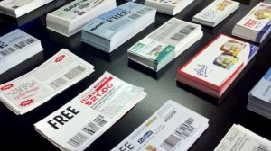
Break Down of The Problem
Mathematic modelling is all estimated
High risk of wasting coupons, distribution costs
Notes:
The challenge facing supermarkets that use this method and do not have loyalty schemes is one of targeting. For Morrisons, the decision of which post code areas to distribute the coupons to was based on mathematical modelling, so it was all estimated.
They also running the risk of sending coupons to people who were never going to use them, or only one time customer.
“What Smart Steps offered us was a means to get real customer insight, instead of estimates. Using weighting and with Telefónica Dynamic Insight’s expertise, we could clearly see the best areas to target, and also the areas that we should avoid,” said Crawford. “There’s nothing else like Smart Steps on the market. Using its analysis of journey patterns, we could avoid sending coupons to households who already shop with us regularly, and combined with insight from gravity modelling, avoid targeting households in the direct vicinity of a competitor.” Morrisons decided to run a trial as part of a campaign in the South West of England. Of 11 million households, approximately 400,000 were targeted using insight from the team at Telefónica Dynamic Insights and Smart Steps.

Slide 32
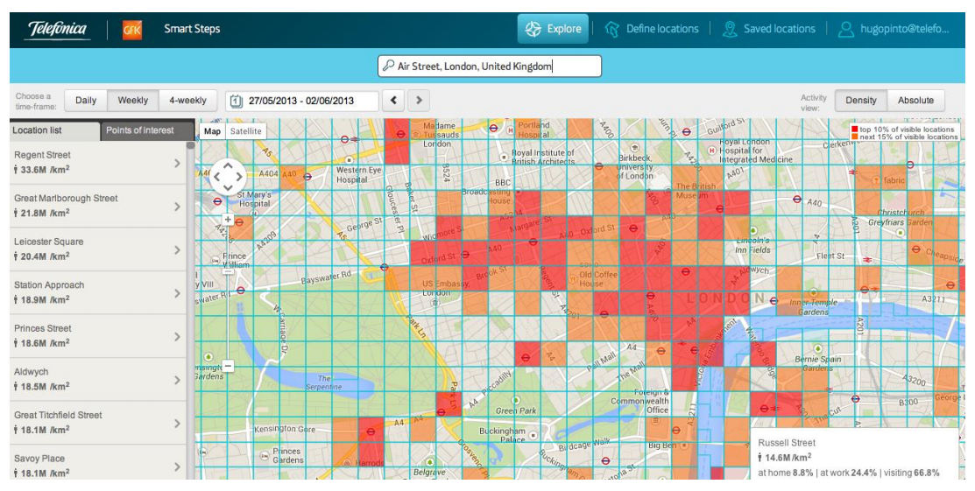
Solution
11 million households
40,000 were targeted
Notes:
Using weighting and with Telefónica Dynamic Insight’s expertise, they could clearly see the best areas to target, and also the areas that
they should avoid.
Using journey patterns, they could send coupons to household who already shop with them regularly, and combined with insights from gravity modelling, avoid targetting housholds in the direct vicinity of a competitor.
Morrisons run trials on 11 millions households, and 400,000 were targetted using insight from the team at Telefonica Dynamic Insights and Smart Steps.

Slide 33
Identify suitable postal code
Sending promotional coupons
Increase proportion of customer responded
Improve New Customer activation rates
Overall
150% in new customers
Notes:
“Smart Steps
identified many more
suitable target post code
sectors, enabling us to
send promotional
coupons to double the
number of households.
This in turn generated
an increase in the
proportion of new
customers who
responded to the offer. This increase in
customers was achieved
without any reduction in
customer spend, and
with an improved new
customer activation rate.
Overall there was a
150%

Slide 34
Implication for Starhub
Decision making
Strategic Planning
Minimize Implementation Cost
Evaluation
Store performance, advertising policies
Frequency of Visits vs frequency of Purchase
Predict Demand
Planning for peak and troughs
Just-In-Time (JIT) inventory
Location
Investment planning
Traffic patterns
Notes:
Measures impact of decisions. Verify the impact that your decision on your outlets to minimize costs of implementation and strategic planning.
Measures store performance. Compare different stores, different locations, advertising policies , promotions campaigns to establish new effective ways to measure their performance. Understanding which sites have the highest frequency of visits vs frequency of purchase (revenue), and which locations have the most loyal customers.
Predict demand. Gain insights in planning for peak and troughs in demand to ensure the stores have the right resources available at the right time, this will ensure Just-In-Time Inventory. Cutting the storage cost, lower inventories holding at anytime. Furthermore, reduce the churn number due to low quality service, especially important for perishable products.
Understanding location- Enable more informed decisions on investment to certain locations by understanding the profile of the customers in the area, frequency of visits and number of traffic in and out of the location.

Slide 35
Real time analysis

Slide 36

Case 1 : MTS India
Customer:
MTS India
Industry:
Telecoms
Problem:
High turn over rate
Solution:
Partner with Hewlett Packard (HP) Enterprise to focus on customer loyalty and retention,
Notes:
MTS India, the mobile telecom service brand of SSTL, has over 13 million customers' in India.
Focus on customer loyalty and retention, which required IT to provide high performance analytics that is easily accessible by marketing to enable the rapid roll out of competitive incentive campaigns

Slide 37
Solution
Gather info
Process using HPE Vertica*
Rewards
*Vertica is the name of HPE analytic tool
Notes:
To keep tabs on customer activity, MTS primarily gathers usage data from its prepaid service customers from several core IT and Network elements, all collected by HPE Vertica for marketing campaigns. This data staging / loading solution provides a business-critical platform for the development of online, close to real-time MTS marketing campaigns for direct 1 to 1 customer outreach. The MTS system allows the telco company to capture what a customer is doing at any given point in time, and provide an instant customer gratification offer around that usage.

Slide 38
Furthermore, MST India
Used to | Now
Batch Processing | Automatic real time processing
Industry success rate 3% | Successful promotion  to 6%
Limited to 24 hr data Update | Processing done in 30 minutes
Notes:
Before MTS began running analytics against its data, the company used what the CIO described as “a rudimentary system for batch processing of data related to marketing campaigns, which limited us to a 24 hour gap between receiving the critical data and making new offers to the customer. Back then, we were collecting data from IT and network elements, then sending it to a standard database implementation for our back-end, where we stored campaign-related tables and customer segmentation data.”

Slide 39

“By rewarding new or recently upgraded customers with surprise bonuses in the form of extra minutes or additional data, we have more than doubled our conversion rate, from an industry average of 3% to an unprecedented 6.5%. No one else in our marketplace is achieving these numbers.”
Marketing teams are now able to run U&R campaigns independently, without involving IT support
— Rajeev Batra, CIO, MTS India Telecom
Notes:
U&R = Usage and Retention

Slide 40
Congestion control

Slide 41

Traffic solutions
Customer:
City Management & midsize utilities
Industry:
Government
Problem:
Overcrowding, High Accident rate
Solution:
+Better allocation due to incident report.
+Improve traffic flows
+Identify inefficiency
+Updates on road accidents
Notes:
Better allocation and distribution of resources based on information from incidents, service disruption.
Analyzing the movement of people to improve traffic management, park capacity, location, and number of first unit responders. City officials can better prepare and react to potential bottlenecks and other issues in case of an emergency.
Identify inefficient traffic pattern so that they can improve traffic management/ re-rounted/ better allocate public safety resources in places where majority of people congregate.
Monitor social media updates so as to report bad weather, major traffic accidents or traffic jams locations so that the city can take best course of action.

Slide 42

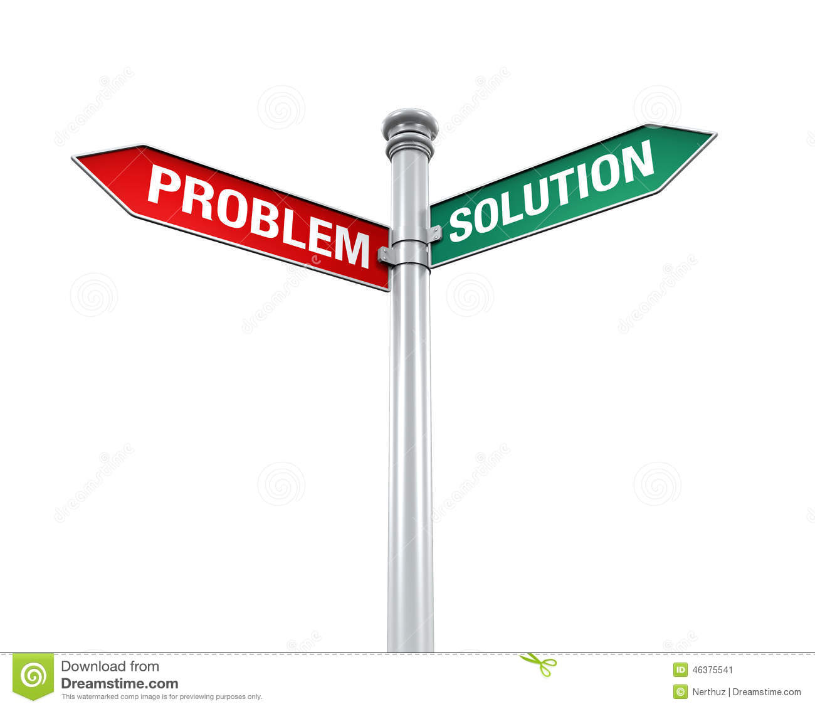
Traffic solutions
Traffic Volume
 Congestion
 Road Safety
Speed harmonization
Network diversion
Congestion Warning
*Highway authority South Bavaria, Germany
Notes:
Problem: Particularly, but not exclusively, in conurbations and metropolitan areas, constantly increasing traffic volumes are leading to more and more congestion on freeways and expressways. During peak times in particular, this has extremely negative impacts on travel times, traffic safety and traffic-related pollutant emissions. Consequently, the responsible authorities are looking for maximally sustainable ways of improving traffic flows without expensive construction measures to expand the motor - way network.
The solution
Using current traffic data as input, active traffic management approaches and dedicated control systems can manage high traffic volumes dynamically to counteract impending congestion. Improve traffic throughput, generates incident warning. Active Traffic management also include + Speed harmonization, Temporary Shoulder use, Ramp metering, Network control/ diversion, Congestion warning, Environmental information.

Slide 43
Traffic solutions
35% fewer
accidents
31% fewer
injuries to road users
20% reduction
in congestion hours
Enhanced road capacity
Improved traffic synchronization and higher capacity during peak hours
Notes:
Here are some striking results of current studies:

Slide 44
Dynamic profiling and segmentation

Slide 46
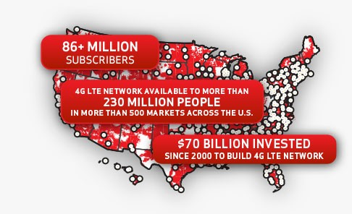
Precision Market Insights
National population
Locations
Demographic
Usage Data
Gender
Age
Target audience:
Media owners, sponsors, advertisers, venue owners and retailers.
Notes:
Precision Market Insights partners with BlueKai, the data management provider; Brightroll, a video ad platform; and the programmatic ad tech providers RUN and Turn.
The four will now sell its tool to advertisers for mobile ad campaigns that target Verizon's massive subscriber base based on demographics, interests and geography. Employing Anonymous Targeting called PrecisionID. When consumers visit certain websites or mobile apps, a request is sent through a Verizon network. Precision packages the request, as a hashed, aggregated and anonymous unique identifier, and turns it into a lucrative chunk of data for advertisers.

Slide 47

Case 1:Connect Consumer Dots for NBA Teams, Sponsors
Learn about attdendees
Connecting Sponsor Message during game
Visits to sponsor location after the game
Notes:
The idea is to help teams and arenas learn more about event attendees, connecting the dots between sponsor messages at the game and visits to sponsor locations afterwards.
The National Basketball Association's Phoenix Suns tested the service last season, and the Portland Trail Blazers are considering a partnership with the telecom's insights business.

Slide 48
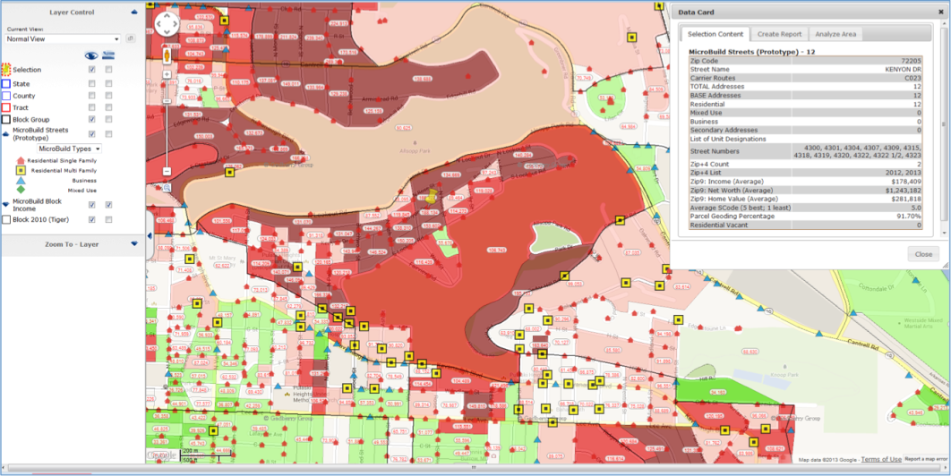
Solution
Utilize granular location data
Track Verizon Wireless-enable devices
Provide Aggregated Data on the types of people
Analyze buying pattern after the game
Notes:
Verizon uses that granular location data to keep track of which Verizon Wireless-enabled devices were in a sports arena, or near it, or at a particular fast food restaurant or car dealership. Though Verizon holds on to that device-identifiable data, it provides a more general view to its clients after "hashing" or anonymizing the data. Clients like the Suns end up with aggregated data on the types of people who visited a venue and later visited a sponsor's place of business.Verizon layers on Experian profile data to segment consumers demographically. For example, it can report which percentage of an audience segment who attended a game then visited a sponsor's burger joint at a particular time on a given day afterwards.

Slide 49
8.4% in traffic following promotional games
Attendee’s demographic
Attendee’s Location
Campaign Response data
Notes:
After the trail, Jack in the Box the fast food eatery "experienced an average increase of 8.4% in traffic following promotional games,“
Verizon provided the team with demographic and location data, mobile usage information, and campaign response data.
In addition to illuminating consumer response to sponsor messa.
Oftentimes one person buys multiple tickets, in which case teams and venues don't know who all of the attendees are. The secondary ticket market only obscures their view more.ges, Verizon aims to fill in the blanks for venues on who's coming to their events

Slide 50
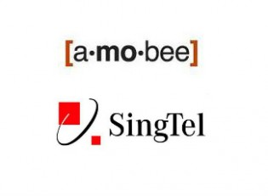
Amobee is a mobile advertising technology company providing services for large advertisers, publishers and operators

Slide 51




Amobee Acquisition
400 million
mobile customers
Notes:
Singtel, as compare to Verizon, takes a different approach to the matter by acquiring a mobile advertising firm Amobee. A vertical integration approach would allows Singtel to potentially enhance the capacities of Singtel Group operators in the Asia market in the emerging digital marketing technolocy, as well as creating a big opportunities for SingTel in emerging markets, such as India, Indonesia, Thailand and the Philippines.
According to Singtel:
Singtel already has advanced geo-localisation capabilities, as well as the means to empower customers to receive only relevant and customised offers and promotions catering to their needs and preferences while protecting their privacy. Furthermore, Singtel’s access to the Group’s over 400 million mobile customers offers a compelling proposition for brands wanting to reach customers in the emerging markets. Amobee complements these capabilities with a strong technical platform that serves ads, banner as well as video ads and an experienced team in mobile advertising.

Slide 52
Case 2 : Amobee and Lexus Automotive Case Study
Customer:
Lexus and Walton Isaacson
Industry:
Automotive
Problem:
Improve effectiveness and engagement
Solution:
Partnership with GfK, to shows trends of how many people visit an area by time, gender and age
Notes:
GfK is a market research firm, focuses on Automotive, Consumer Good, Energy, Fashion and Lifestyle
With each household going shopping an average 4.9 times a week, averaging at two to three different supermarket brand visits in a twelve week period, Morrisons needed to find a new way to increase the number of customers visiting its stores. Without investing in a huge loyalty card programme.
Since Morrisons don’t have store card to tell them who their customers are, they cannot implement effective targeted marketing, over-rewarding one customer disadvantages them in investing in the next one.

Slide 53
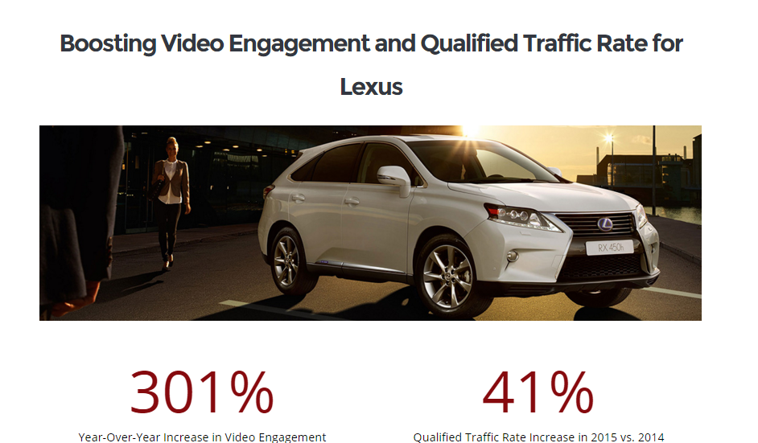

Slide 55
Implication for Starhub
Control
Advertising performance
Analyze competitor activities
Platform
Identify best approach
Location-based
Promotions, offers, deals
Service Quality
Personalized mobile plan
Improve service and reduce churn
Determine best hour of the day
Push upcoming sales
Notes:
By combining the customer location information with customer demographics and preferences, CSPs are starting to provide Data Analytics as a Service (DAaaS) to other key verticals including: retail, financial services, advertising, healthcare, public services and other customer-facing businesses
Measure advertising performance at particular location by the rate of visits, the increase in number of visits to outlets, analyze competitor activities as well. This would allows a more informed understanddetermining ing for the return of investment in advertising campaign.
Finding effective advertising flatform. Potentially, identify location and match with particular demographic, time of the day for product pricing in Singapore, which is applicable for outdoor billboard, banners, advertising screen.
Advertising content based on location. Meaning, social media, websites and online content can be tailored to for advertising based on location of the person by showing near by promotions, discount, sales, or items of interest to the users based on their browsing pattern.
Personalized deals, offers, promotions and coupons. Advanced analytic would enable Starhub to engage in personalized offers and promotions, which helps to increase customers satisfactions and reduce spamming which eventually reduces churning. For example, using analytic system to monitor data usage, call minutes per month to offer additional package on top of the standard plan when the users reach their limits.
Advertisers partnering with Starhub could reach specific demographic segments on mobile, identify and serve ads to loyal customers, and re-target particular users based on our Data Science and Data Solution team.

Slide 56

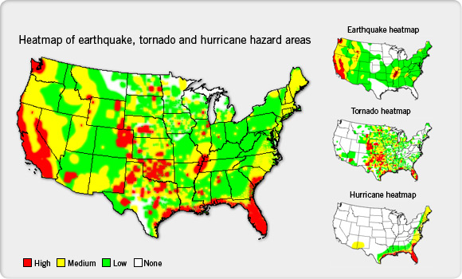
Insurance Company
If I’m an insurer that wants to accurately price insurance coverage on a particular house, I need to know, are you in an earthquake zone, a flood zone, or are you in an area that is prone to wildfires
-- Bill Sinn,marketing director
Notes:
Pitney bowes is eCommerce solutions, shipping and mailing products, location intelligence, customer engagement and customer information management solutions. And this is how it takes on Insurance Company.
“If I’m an insurer that wants to accurately price insurance coverage on a particular house, I need to know, are you in an earthquake zone, a flood zone, or are you in an area that is prone to wildfires,” says Bill Sinn, marketing director for insurance and healthcare at Pitney Bowes. “And, if I know a major storm is approaching I want to know, with precision, that I’ve got 50,000 policy holders that could be impacted.”
Sinn says that products like MapInfo Professional, which allow users to visualize geospatial data, have revolutionized the way insurance underwriters, actuaries, claims, and marketing professionals utilize the information. “Underwriters previously had to look at a spreadsheet,” Sinn says. “But now they can visualize it and look spatially and say, how many other policy holders do I have near that location?” While data used to be broken down by zip code, Sinn notes that MapInfo Professional lets users drop a pin in a location and then micro-analyze data however they choose—for example, by creating a mile-radius ring around the projected storm path.

Slide 57
Insurance Company
Profit
Efficiency
Profit
Offers
Pricing decision
Competition
Well informed
Accurate exposure
Up-to-date data
Distribution
Marketing
Maximize Effectiveness
Notes:
Hence, location intelligence tools can assist insurers by:
• Accurately assessing marketing potential, better focusing
marketing, sales, and distribution management, and
maximizing producer effectiveness
• Improving underwriting decisions by providing more
accurate exposure analyses
• Increasing competitiveness through more refined and
accurate pricing.
• Increasing organizational efficiency and profitability through
deployment of “low touch” or “no touch” automated
underwriting systems, augmented rules engine technology,
and enhanced service-oriented architectures supported by
web services applications
• Managing risk on a portfolio basis and complying with
regulatory reporting requirements
• Streamlining claims handling processes and providing
added-value customer service offerings

Slide 58
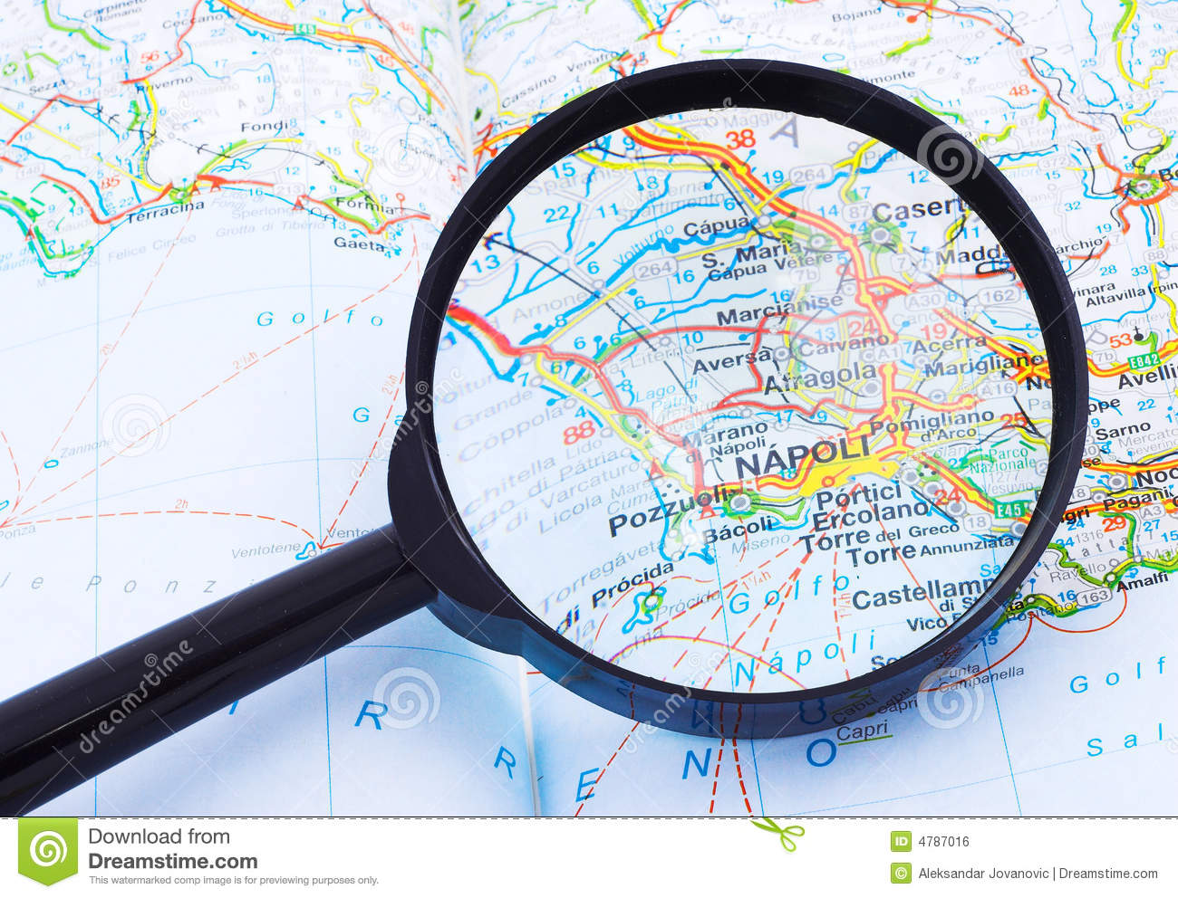
Banking Services
Currently,
$25 million.
$100 million worth of potential business
Notes:
Through the understanding of its trade area, they can assess its relative performance. For instance,
. “Based on an understanding of the demographic profile of the area which suggests that there is $100 million worth of potential business in the area, but the branch is only generating $25 million.

Slide 59

Solution
Local Leadership
Product Mix
Demographic
Income
Competitive positions
Reassess the targets
Detect Fraud
Anomaly Credit card usage
Sending Offers
Manager
Notes:
Further evaluation can be conducted to better understand this shortfall. The regional manager could re-evaluate
local leadership,
the mix of products/services offered in that branch,
better understand competitive positions within the market,
and/or reassess the targets for that branch.”
Banks and credit card companies can also use location intelligence tools to better detect fraud, and also avoid flagging legitimate charges as potentially fraudulent. “As they start to develop profiles of where you shop, that makes it a bit cleaner to anticipate charges that on the surface might seem a bit outside the norm,” says Hempfield. “There’s nothing worse than when a customer tries to buy a plane ticket, and the bank, because the airline’s call center is in a different state or country, thinks it’s an illegitimate charge and rejects the purchase.”
Hempfield explains how financial institutions can use geospatial data to electronically send their cardholders special offers when they’re at or near specific stores. “Banks and credit card companies want to help drive additional business to their network of retailers,”

Slide 60
Implication for Starhub
API
Selling Processed Data
Provide Library to access Aggregated Data
Service
Provide analytic service
R&D
Possible solution for firms
Utilize solution team to solve customer
Identify potential threat
Notes:
Selling fraction of processed data- for a particular purpose (such as demographic, crowded area,etc) to LTA.
Selling a whole package of aggregated data. Which is the entire anonymous location based data of starhub customers. So that the buyers can further extract information or perform analysis so as to gain insights.
Selling a final product as a report for a particular purpose. E.g. Starhub could perform necessary analysis on the data obtained and then only produce the required report that the buyers want.
Furthermore, Research and Development into the current data and external data (if possible) could be used to identify out-break of diseases, disaster, social unrest and emering hot-spot.

Slide 61
Potential Future Direction

Slide 62

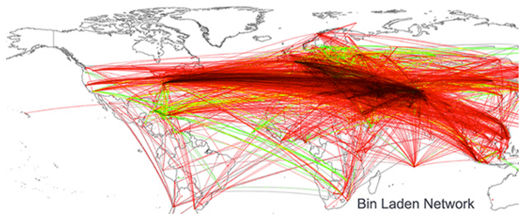
Government - Politics
Criminal activities and security protection
Using location-based report to predict political events
Notes:
Criminal activities and security protection. For instance, University of Illinois computer scientist Kalev Leetaru, written about being able to locate Osama Bin Laden’s location based on mining news report, basically, he connected cities together if they were mentioned in a same article. Then he ended up with the map as seen below, all roads lead to a 200-kilometer radius about Abbottabad. Personally, I would not say this as a reliable way to solve problems, however, this type of new research and studies on human behavior could potentially lead to exciting field of getting political intelligence.
Using location-based report to predict political events: Futhermore, predictive models can be built with data from social media conversations, mobile phones and browsing behavior. Potential illegal activities, gathering can be identify and prevented. Furthermore, historical data might as well give insights into potential triggers for such events in the future.

Slide 63

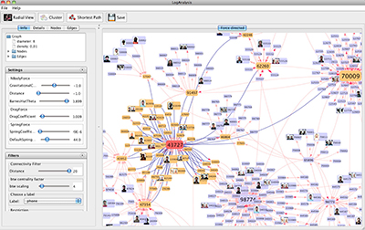
Center for Complex Networks and Systems Research
This network visualization shows a criminal network in Italy based on a case study using unique cell phones and phone calls.
Notes:
Ferrara, a post-doctoral researcher at Indiana University’s Center for Complex Networks and Systems Research,and collaborators from the University of Messina, Italy assisted police in Italy with investigations into murder, bribery, robbery, drug trafficking and prostitution by using social network modeling to conduct criminal network analysis using phone call data obtained by police.
“The researcher create what they call a dynamic spring layout — a series of nodes that represent possible members of criminal networks — and analyze how those members interact and shape their interconnections over time.” Using a software, LogAnalysis, it automatizes the import of raw telephone data, then removes recognized ambiguities and redundancies, before converting the information into a form ready for exploration and analysis. Once the criminal network has been identified, the relationships within such network is analyzed for hierarchical structure.

Slide 64
Overall : IBM big data in Telecom
Conductor:
IBM & Said Business School at University of Oxford.
Industry: Telecommunication
Finding:
Commit initial efforts to customer-centric outcomes
Develop an enterprise-wide big data blueprint
Start with existing data to achieve near-term results
Build analytics based on business priorities
Create a business case based on measurable outcomes.

Slide 65
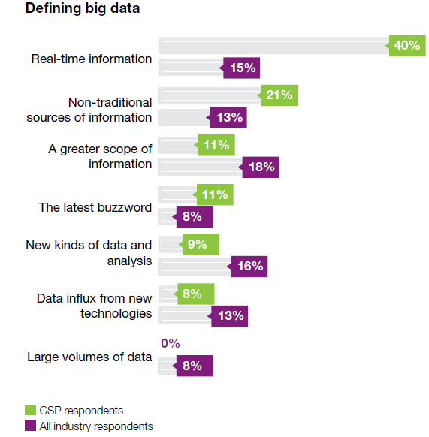
Sample size: 1,144 Business and IT Executives 26 Industries 53 from Telecommunications
Bid Data Role
Notes:
CSPs that can ingest and analyze contextual data in real-time
or near-real time have much to gain. Within big data lies the
opportunity to derive new insights and predict trends that may
spark new ways of doing business internally or externally.
Using big data in delivering location-based services, tailored
marketing campaigns, next best actions for sales and services,
network intelligence, social media insights and high-velocity
fraud detection has the potential of both increasing revenue
and reducing costs, often while improving the customer’s
experience.

Slide 66
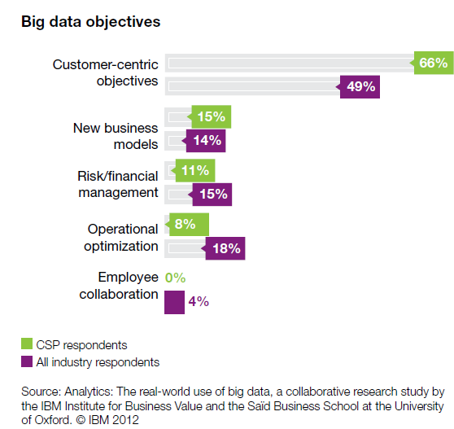
Business Direction
Notes:
Whether CSPs are using big data to support their core
business, or are considering big data sales as a source of
revenue, they need to develop a roadmap, set up an adequate
infrastructure and adopt new methods, processes and tools to
manage the unique volume, velocity, variety and veracity
requirements of big data. By analyzing survey responses, five
key findings emerge that reveal common insights and trends:
• The business case for big data is strongly focused on
addressing customer-centric objectives
• A scalable and extensible information management
foundation is a prerequisite for big data advancement
• CSPs are beginning their pilots and implementations by
using existing and newly accessible internal sources of data
• Advanced analytic capabilities are required, yet often lacking,
for CSPs to get the most value from big data
• The emerging pattern of big data is focused on delivering
measurable business value.

Slide 67
Customer-centric Objective
Telefonica’s Brazillian subsidiary, Vivo
Offer discounted upgrade options
“Smart Steps.”
Tailor local offering for existing stores.
Verizon’s Precision Marketing division
➔Joint promotional opportunities and ticketing packages
Notes:
For example, Telefónica’s Brazilian subsidiary, Vivo,
implemented a solution that uses call data, demographics and
predictive modeling to reach out to customers and only offer
them products and services that match their needs and
lifestyles.
This can preemptively
contact customers who have recently exceeded their allotted
calling minutes and offer discounted upgrade options that
will prevent future overages.
This approach demonstrates to
the customer that Vivo values their business and is likely to
result in a positive customer experience. These types of
customized marketing promotions can help to prevent
churn, increase sales and lower marketing campaign costs.
Telefónica’s Dynamic Insights division launched its first service
in November 2012: “Smart Steps.”
This service is designed to
provide insights to retailers to help them tailor local offerings
for existing stores, and determine the best locations and most
appropriate formats for new stores.
Verizon’s Precision
Marketing division has already trialed its solution with a sports
team. Joint promotional opportunities and ticketing packages
have boosted season ticket sales by up to 35 percent

Slide 68
Risk & financial management Objective
Using real time analytics tools could reduce fraud by more than US$100 million per year.
For example:
T-Mobile ➔ high-value subscribers and services to better target its capital expenditure and networking engineering.
Notes:
One CSP executive estimated that using real time analytics tools could reduce fraud by more than US$100 million per year.As well as driving down overall debt-collection costs, targeting risky customers also has the added advantage of lowering churn rates.
T-Mobile in the United States, for example, is collecting a
staggering 17 billion events a day from its network, storing this
data and running analytics on it.16 This analysis enables
T-Mobile to examine and correlate network performance with
high-value subscribers and services to better target its capital
expenditure and networking engineering.

Slide 69
Non-traditional source of INFO
Monthly account-management cycle
➔ XO communication .
Social media content
➔
Notes:
XO Communications, a wholesale and enterprise-focused CSP
in the United States, has been using predictive analytics with
its monthly account-management cycle to predict churn.
Within the first year, a 60-percent improvement in revenue
retention rates was realized.
By
combining social characteristics with existing behavioral
knowledge, CSPs are able to create extended and deeper
insights to engage and retain customers. Social network
analytics can also be used to find key influencers and engage
them with customized messaging, to evaluate how new
campaigns, product and services are resonating, and to quickly
respond to negative chatter to protect their brands and
reputation. Bharti Airtel, for example, uses social network
analysis to determine customer issues by tracking mentions of
the company on social media and following up on any
problems.

Slide 70
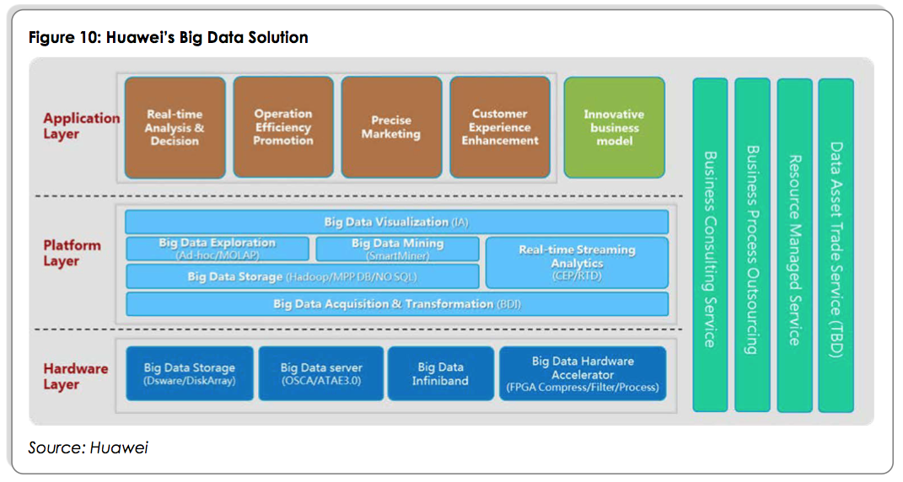

Slide 71
Reference:
Big Data Working Group: Big Data Analytics for Security Intelligence. (Sep 2013) - Cloud Security Alliance
Big Data and Advanced Analytics in Telecom: A multi-billion-dollar revenue Opportunity. (Dec 2013) - Heavy Reading
https://www.pitneybowes.com/pr/articles/how-location-intelligence-is-reshaping-three-different-industries.html
http://www.rcrwireless.com/20141014/big-data-analytics/telco-case-study-vodafone-argyle-data-tag6
https://www.kit.nl/biomedical-research/kit-news/big-data-location-based-applications/
http://www.informationweek.com/big-data/big-data-analytics/cisco-brings-location-based-big-data-to-shopping/d/d-id/1107407?
Case 1: http://dynamicinsights.telefonica.com/wp-content/uploads/2015/04/O2-Retail-Smart-Steps-Case-Study.pdf
Case 2: Smart Steps increase Morrisons new and return customers by 150%
Amobee Case: http://amobee.com/lexus-automotive-case-study/

Slide 72
Reference:
Complex Criminal Networks Detected with Mobile Phone Data. http://www.forensicmag.com/news/2014/04/complex-criminal-networks-detected-mobile-phone-data
Case studies for traffic solutions Modern concepts and technologies help improve efficiency. http://www.mobility.siemens.com/mobility/global/sitecollectiondocuments/en/road-solutions/urban/case-studies-for-traffic-solutions-en.pdf
Making Money Through API exposure. http://www.oracle.com/us/industries/communications/comm-making-money-wp-1696335.pdf
Processing Subscribers’s Personal, Identification, Traffic and Location Data
https://www.t-mobile.cz/dcpublic/VPST-Podminky_zpracovani_OU_EN.pdf
Making the right call
http://www2.deloitte.com/us/en/pages/technology-media-and-telecommunications/articles/real-time-customer-insight-foresight-with-analytics-making-the-right-call-case-study.html
52 Million cars – and zero congestion
http://www.t-systems.com/news-media/big-data-in-traffic-52-million-cars-and-zero-congestion/1011696

Slide 73
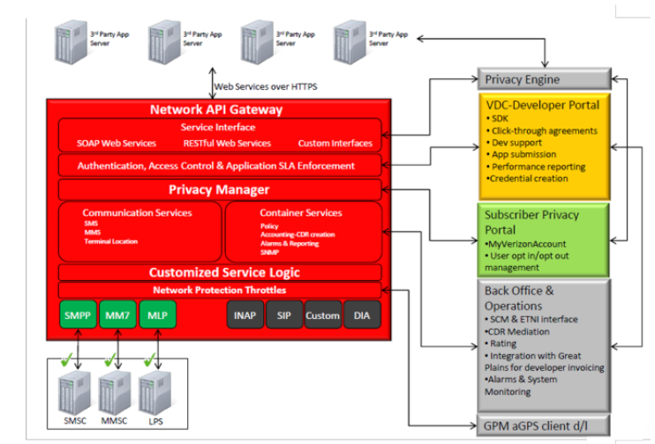
Appendix – Verizon API Architecture

